Slide 1
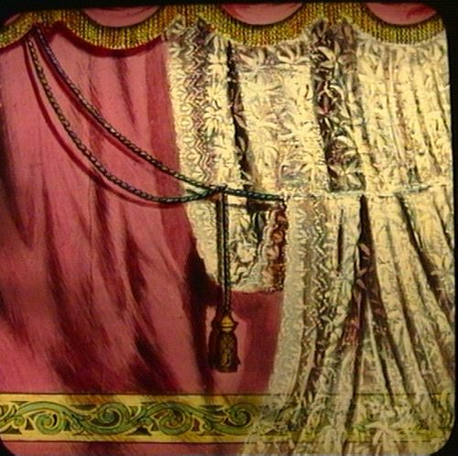
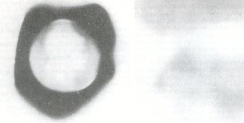
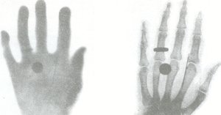
Early Image made by
uranium rays
Image of a hand

Slide 2
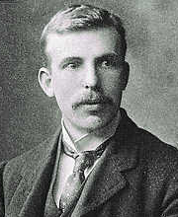
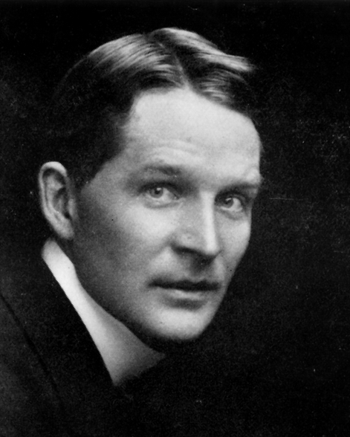

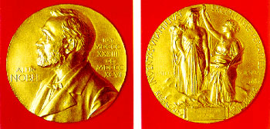
Rutherford & Soddy
at McGill
Professor Emeritus M.A. Whitehead
Director, Canadian and International Constituency Group
Chair of Awards Committee

Slide 3
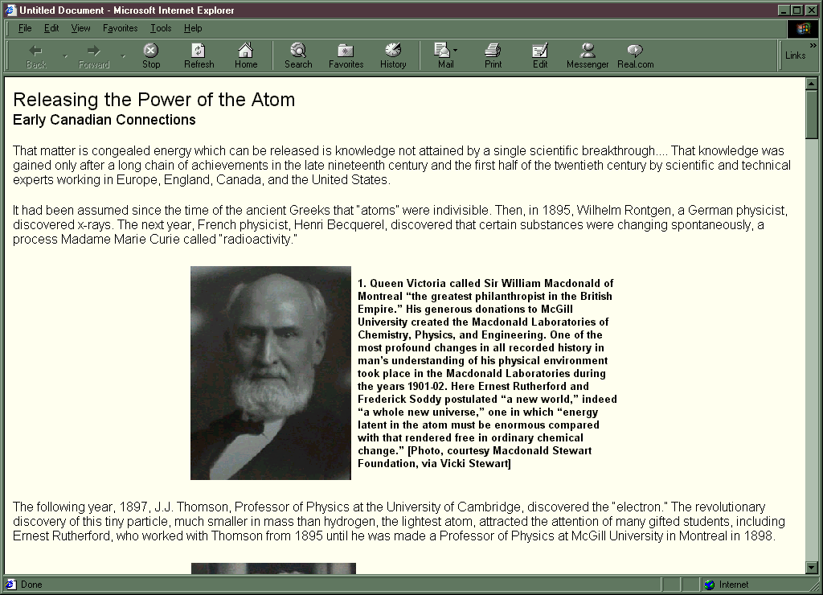
Releasing the Power of the Atom
Early Canadian Connections

Slide 4
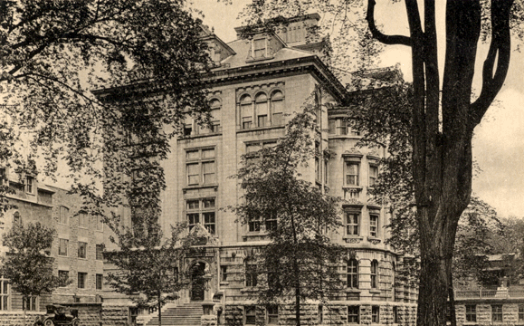
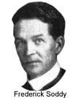
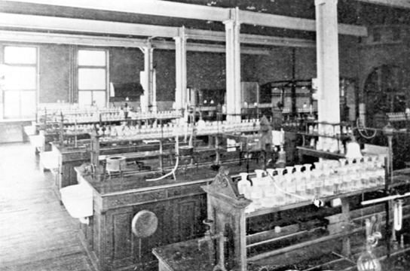
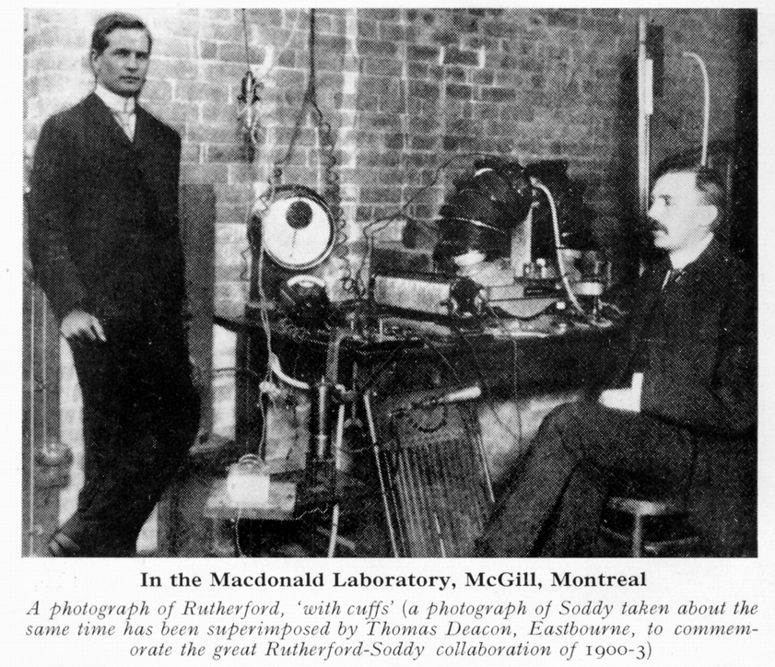
Soddy
at McGill
1902-1904
World tour 1903
MacDonald Chemistry
Building, McGill
1895
Toronto?

Slide 5
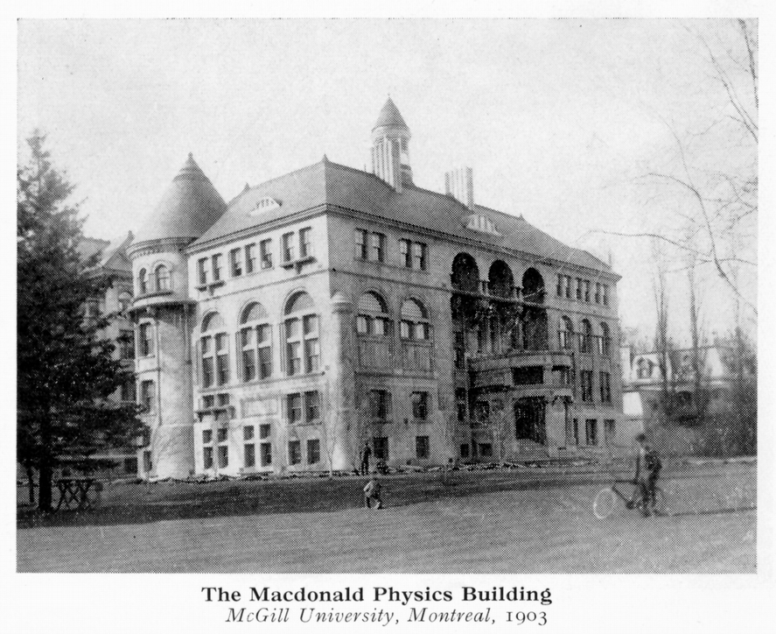

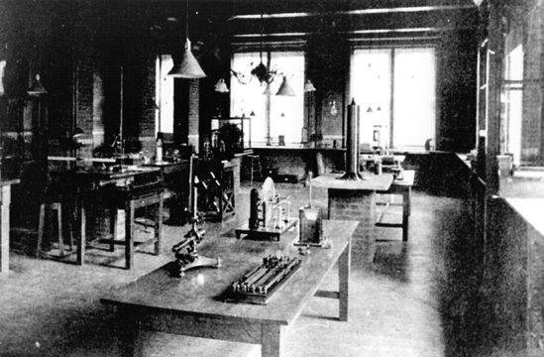
MacDonald Physics
Building, McGill
1903
28th. March, 1901
“The existence of Particles
smaller than Atoms”:
Soddy then Rutherford:
ROW!!
Continued next week!

Slide 6
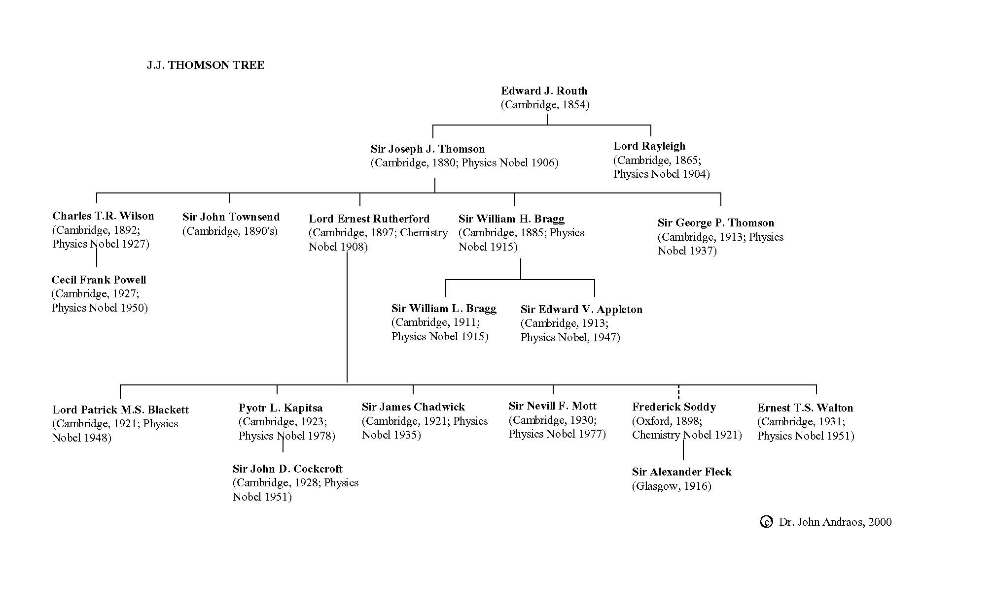


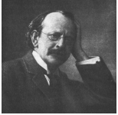




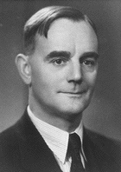

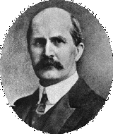
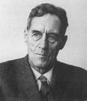



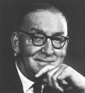
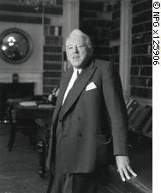

Slide 7
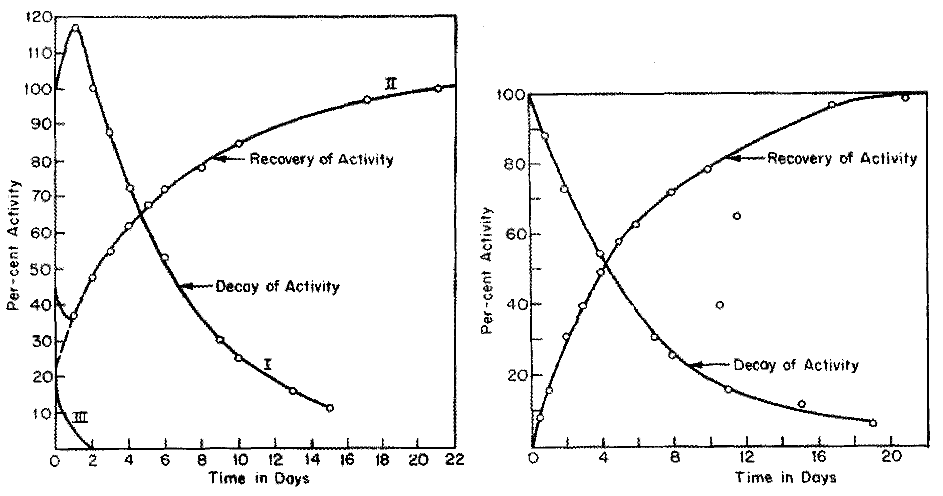
Soddy & Rutherford Research
“Soddy don’t call it transmutation!”
1) Disintegration theory 1902
2) Radioactivity of thorium 1902
0.8 cm/sec
substance
2:1
Thorium emanation
half life =1 min.
H2SO4
Thorium
Thorium
Better separation
Thorium X
Thorium X

Slide 8
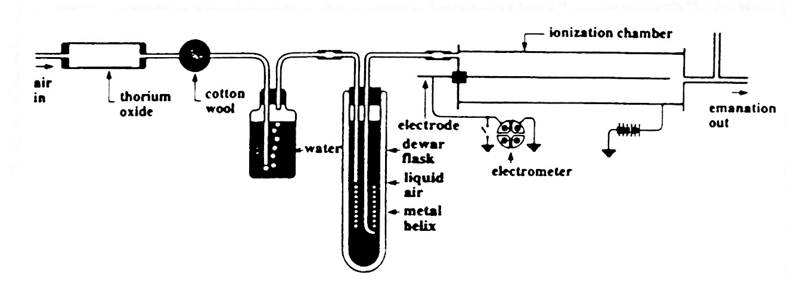
3) The cause and nature of radioactivity, 1902
4) The gaseous emanation from thorium found to be like argon
5) Condensation, 1902: thorium emanation condensed at
–150ºC, i.e. a real gas
Soddy & Rutherford apparatus 1902, to condense emanations

Slide 9
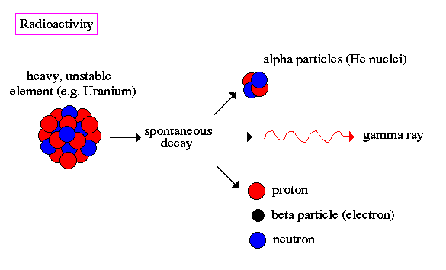
6) Radioactivity of uranium, 1903
7) The half-life of radon, 1903
8) Radioactive change, 1903
(a) radium, thorium and uranium radioactivity gave new matter
(b) radioactive decay function of several types of matter change
(c) radioactivity was an atomic phenomenon

Slide 10
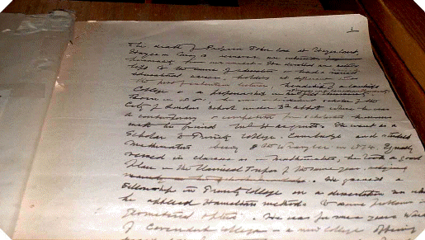
Rutherford Letter describing Nobel Prize Award to E.S.Eve 1908

Slide 11
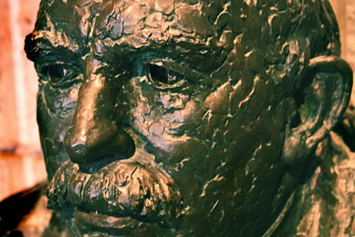
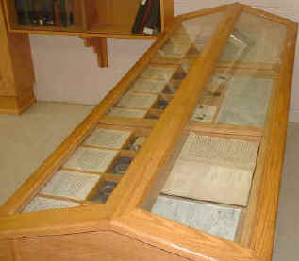
Radium decay cabinet: Rutherford Museum, McGill

Slide 13
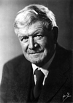
You learned to count as far as three;
And saw that Heat was got from Fire.
Moved into Theory, went higher,
You did not know it, but you were
The first Research Professor, sir,
Contained, within your hairy Body,
A noble Rutherford or Soddy.
Nay, -- what is more, -- your Lot was rude
But showed the College attitude,
You made it an unswerving Rule
To disregard the Common Fool,
You overlooked the silly chaff
Of Laughing Jackass, gay Giraffe,
You heeded not the caustic Smile
Of Dinosaur or Crocodile,
Passed undisturbed the Ridicule
Of comic Crow or haw-haw Mule, --
In short, in Culture's earliest Span
You acted like an Oxford Man
Stephen Leacock

Slide 14
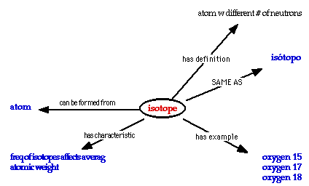
Lectureship in Physical and Radio Chemistry at Glasgow University.1904-1914.
1) Book delayed because of Rutherford’s
2) Advised the Cassel Cyanide Company of Glasgow: 50 kilograms of uranyl nitrate allowed proof that radium grew from uranium.
3) With Alexander Fleck, discovered
(a) many short-lived radioactive elements
(b) chemically inseparable
(c) spectroscopically identical
(d) disintegrated differently.
Dr Margaret Todd suggested ‘isotope’.
Soddy immediately adopted the term.1913

Slide 15
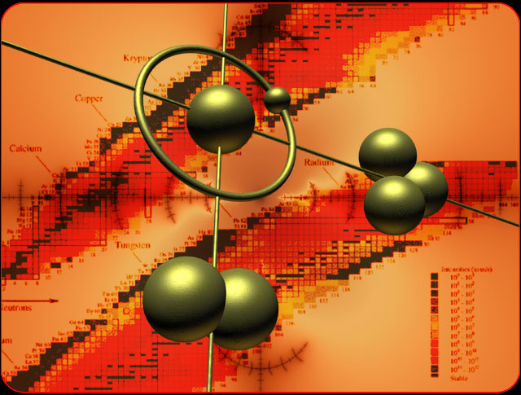
ISOTOPES 1913

Slide 16
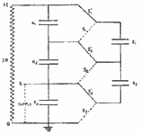
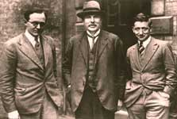
SPLITTING THE ATOM 1932: Rutherford
To penetrate the nucleus, Cockcroft and Walton built a voltage multiplier: they build a potential of 800 kilovolts. The potential accelerated protons down an evacuated tube eight feet long. In 1932 they put a lithium target at the end of the tube and found that protons disintegrated a lithium nucleus into two alpha
particles.
John Cockcroft, Ernest Rutherford, and E.T.S. Walton.

Slide 17
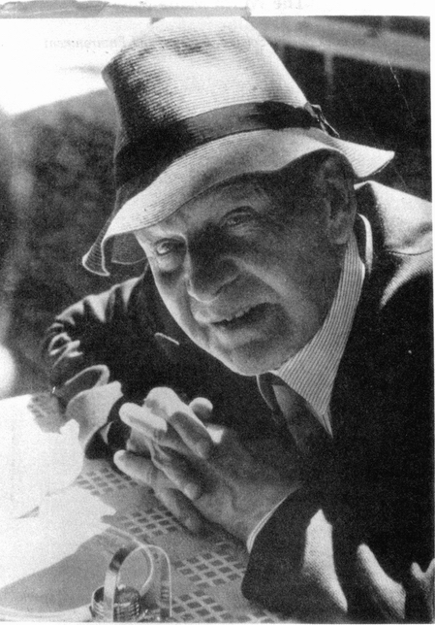
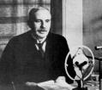
Rutherford & Soddy
1903
1921
The Nobel Prize in Chemistry

Slide 18

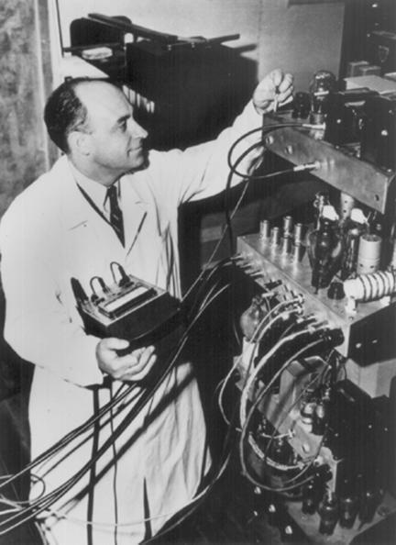
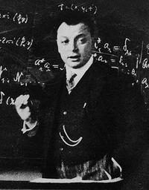
Neutrino
beta decay
1899; Rutherford discovered uranium compounds to produce three kinds of radiation; according to their penetrations named α, β, and γ.
E. Fermi (1933)
W. Pauli (1930)
ν_{e}
˜
ν_{e}
˜
ν_{μ}
ν_{μ}
By analogy with quantum theory, predicted neutrino’s weak interaction with matter
From non conservation of energy and momentum in beta decay

Slide 19
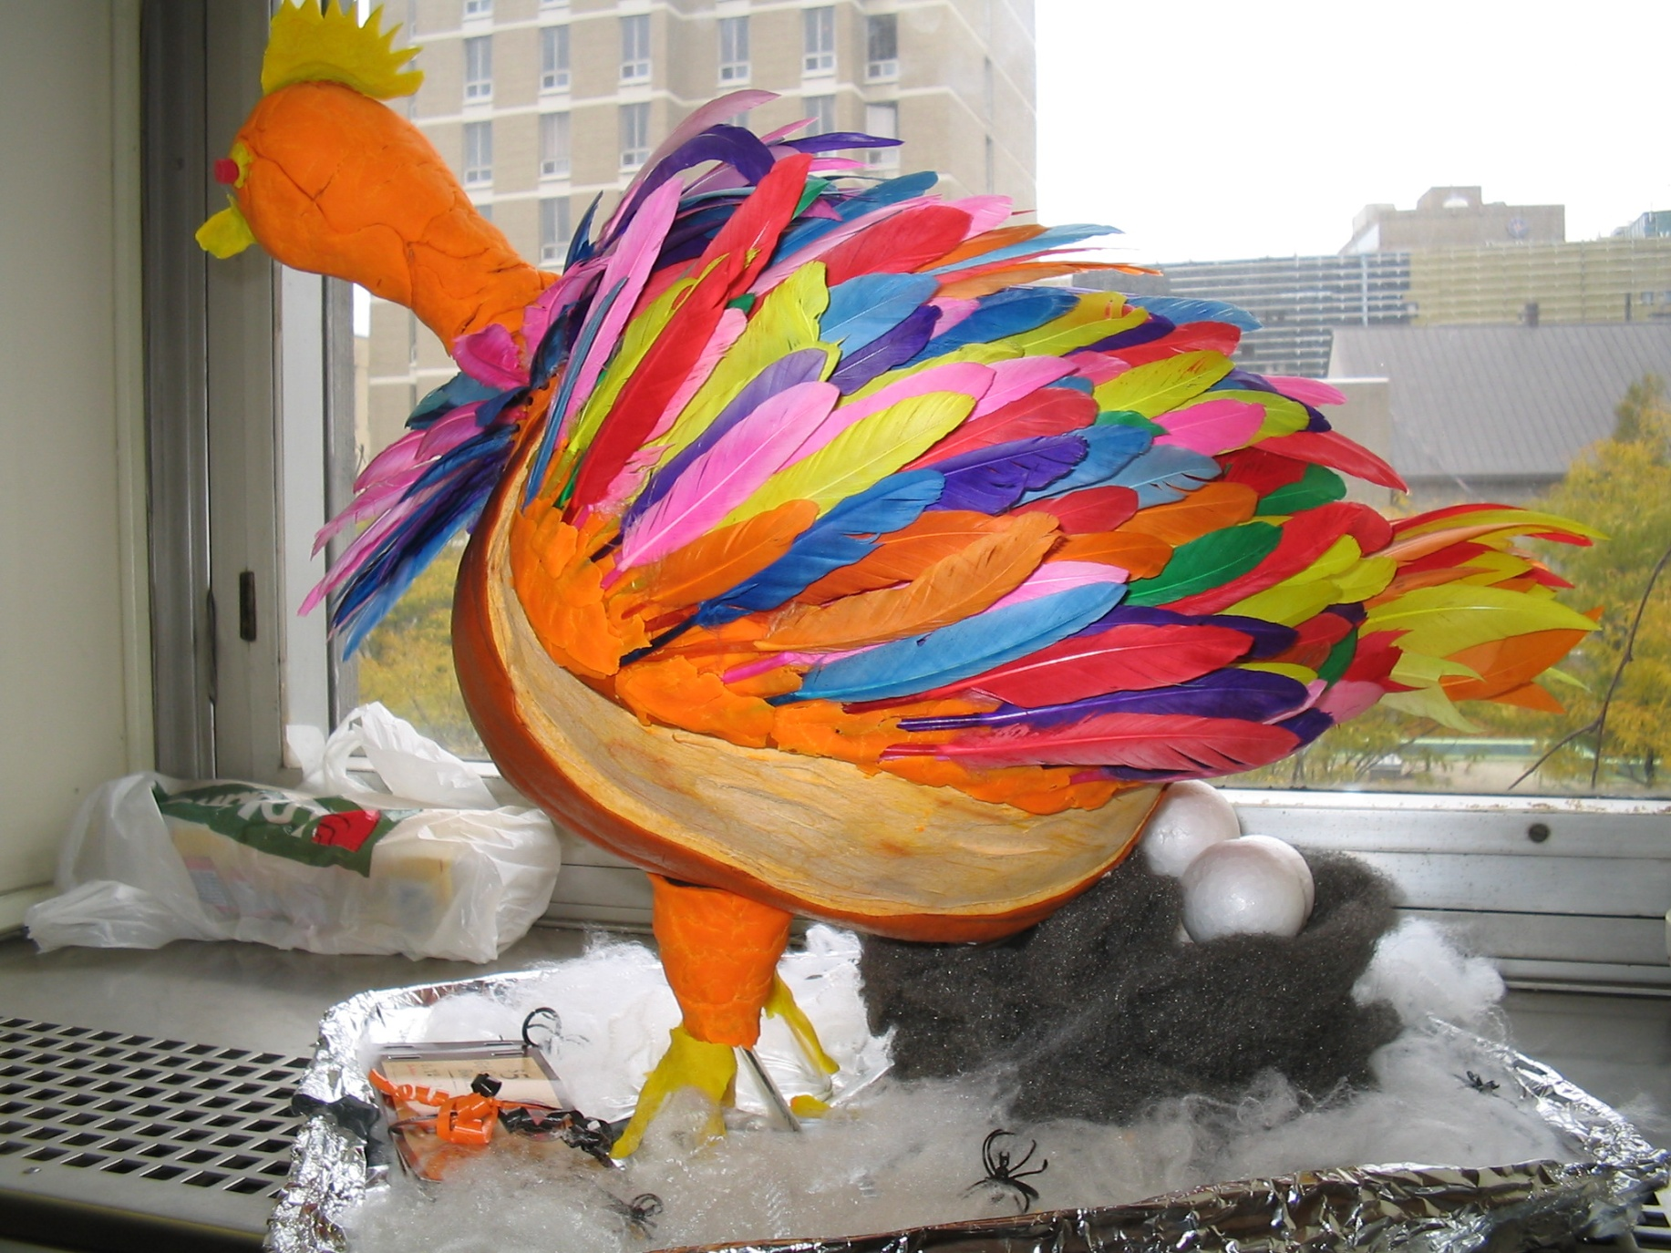
OUR PUMPKIN MASCOT

